Slide 1

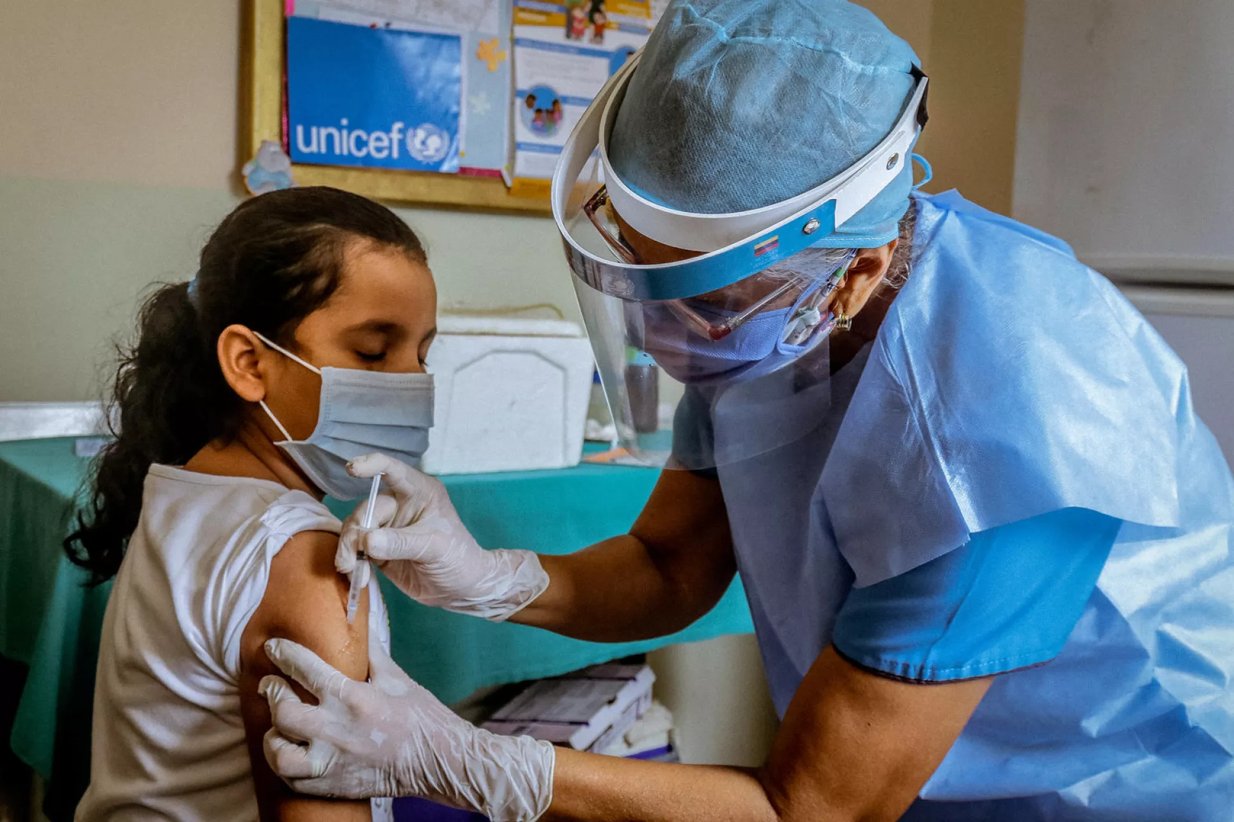
Vaccines and Vaccine-
Preventable Diseases
EMS 313 / Chapter 6
Notes:
Teaching narrative:
Begin with a question relevant to our work: Why does a paramedic need to understand vaccines even when they do not administer them? We often encounter disease before the diagnosis is confirmed. Early recognition and appropriate precautions can protect the patient and the team. We will begin with how immunity develops, apply these principles to individual diseases, and finish with an EMS scenario.
Source lecture: supplied Chapter 6, Vaccines and Vaccine Preventable Diseases. Content reorganized and updated for teaching.
References (accessed 12 October 2026):
Clinical application follows current Saudi MOH guidance and local EMS protocols.

Slide 2
01 / PRINCIPLES OF IMMUNITY
Learning objectives
Distinguish active immunity from passive immunity.
Explain the main vaccine types using familiar examples.
Recognize key features of vaccine-preventable diseases.
Choose appropriate precautions and use current vaccine guidance.
EMS 313 / Chapter 6
2
Notes:
Teaching narrative:
This slide outlines the lecture. Our goal is to understand why we use each vaccine type and how that knowledge informs patient care. For each disease, we will connect a clinical clue with its route of transmission and a method of prevention.
Source lecture: supplied Chapter 6, Vaccines and Vaccine Preventable Diseases. Content reorganized and updated for teaching.
References (accessed 12 October 2026):
Clinical application follows current Saudi MOH guidance and local EMS protocols.

Slide 3
01 / PRINCIPLES OF IMMUNITY
Why vaccines matter
Vaccination prepares immune defenses before exposure.
It reduces the risk of disease and serious complications.
An antigen is a substance the immune system can recognize.
Vaccines present antigens—or instructions to make them—without requiring the natural disease.
Primary prevention: act before disease occurs.
EMS 313 / Chapter 6
3
Notes:
Teaching narrative:
Imagine that the body first encounters a microorganism during a severe illness. It needs time to respond. A vaccine introduces an appropriate antigen in advance, which is why vaccination is a form of primary prevention. Vaccines can contain weakened or inactivated organisms, selected components, or instructions for producing an antigen.
Source lecture: supplied Chapter 6, Vaccines and Vaccine Preventable Diseases. Content reorganized and updated for teaching.
References (accessed 12 October 2026):
https://www.cdc.gov/pinkbook/hcp/table-of-contents/chapter-1-principles-of-vaccination.html
Clinical application follows current Saudi MOH guidance and local EMS protocols.

Slide 4
01 / PRINCIPLES OF IMMUNITY
Active and passive immunity
Feature | Active immunity | Passive immunity
Source | The body makes its own response | Ready-made antibodies are received
Onset | Develops over days to weeks | Immediate protection
Duration | Often long-lasting; memory develops | Temporary; usually weeks to months
Examples | Vaccination or natural infection | Maternal antibodies; immune globulin
Active = build a response. Passive = receive antibodies.
EMS 313 / Chapter 6
4
Notes:
Teaching narrative:
Compare a student who learns a skill with a student who receives immediate help. Active immunity takes time to develop and creates immune memory. Passive immunity provides ready-made antibodies that act immediately but decline over time. Natural infection can produce immunity, but it can also cause complications. Appropriate vaccination provides a preventive alternative.
Source lecture: supplied Chapter 6, Vaccines and Vaccine Preventable Diseases. Content reorganized and updated for teaching.
References (accessed 12 October 2026):
https://www.cdc.gov/pinkbook/hcp/table-of-contents/chapter-1-principles-of-vaccination.html
Clinical application follows current Saudi MOH guidance and local EMS protocols.

Slide 5
01 / PRINCIPLES OF IMMUNITY
How active immunity develops
Antigen exposure activates specific B and T lymphocytes.
B cells can produce antibodies against that antigen.
Memory cells support a faster response to later exposure.
A primary series builds protection; booster doses may reinforce it.
Protection is not immediate after the first dose.
EMS 313 / Chapter 6
5
Notes:
Teaching narrative:
Connect the previous table with what happens inside the body. Antigen recognition triggers an immune response, and memory cells remain afterward. This explains why some vaccines require several doses and why boosters may be necessary. Vaccine type, age, and immune status affect the strength and duration of the response.
Source lecture: supplied Chapter 6, Vaccines and Vaccine Preventable Diseases. Content reorganized and updated for teaching.
References (accessed 12 October 2026):
https://www.cdc.gov/pinkbook/hcp/table-of-contents/chapter-1-principles-of-vaccination.html
Clinical application follows current Saudi MOH guidance and local EMS protocols.

Slide 6
01 / PRINCIPLES OF IMMUNITY
When passive immunity is useful
Maternal antibodies cross the placenta and protect the newborn temporarily.
Immune globulin can provide rapid protection after selected exposures.
Examples include hepatitis B immune globulin (HBIG) and tetanus immune globulin (TIG).
6
Notes:
Teaching narrative:
Now imagine that an exposure has already occurred and we cannot wait for active immunity to develop. A clinician may give ready-made antibodies and, in some situations, a vaccine to provide future protection. Examples include certain hepatitis B exposures and wounds that pose a tetanus risk. Depending on the situation, both products may be necessary.
Source lecture: supplied Chapter 6, Vaccines and Vaccine Preventable Diseases. Content reorganized and updated for teaching.
References (accessed 12 October 2026):
https://www.cdc.gov/pinkbook/hcp/table-of-contents/chapter-1-principles-of-vaccination.html
https://www.cdc.gov/tetanus/hcp/clinical-guidance/index.html
Clinical application follows current Saudi MOH guidance and local EMS protocols.

Slide 7
01 / PRINCIPLES OF IMMUNITY
Main vaccine types
Type | What is used? | Examples
Live attenuated | A weakened, living organism | MMR; varicella
Inactivated | An organism that cannot replicate | IPV; hepatitis A
Toxoid | An inactivated bacterial toxin | Tetanus; diphtheria
Protein subunit / recombinant | Selected antigens | Hepatitis B; acellular pertussis
Polysaccharide | Capsule sugars alone | PPSV23
Conjugate | Capsule sugars linked to protein | Hib; PCV; MenACWY
These categories can overlap: recombinant describes how an antigen is made.
EMS 313 / Chapter 6
7
Notes:
Teaching narrative:
This table summarizes the vaccine types covered in the chapter. We move from a weakened living organism to an inactivated organism, an inactivated toxin, and selected components. The final two rows distinguish a polysaccharide alone from a polysaccharide linked to a protein. Recombinant technology describes how an antigen is manufactured, so a recombinant vaccine may also be a subunit vaccine. Other platforms, such as mRNA, are outside this chapter's detailed focus.
Source lecture: supplied Chapter 6, Vaccines and Vaccine Preventable Diseases. Content reorganized and updated for teaching.
References (accessed 12 October 2026):
https://www.cdc.gov/pinkbook/hcp/table-of-contents/chapter-1-principles-of-vaccination.html
https://www.cdc.gov/vaccines/glossary/index.html
Clinical application follows current Saudi MOH guidance and local EMS protocols.

Slide 8
01 / PRINCIPLES OF IMMUNITY
Live attenuated vaccines
Contain a weakened form of the organism.
The vaccine organism replicates to stimulate immunity.
Examples include MMR and varicella vaccines.
Generally avoided during pregnancy and in severe immunosuppression.
Live attenuated does not mean unable to replicate.
EMS 313 / Chapter 6
8
Notes:
Teaching narrative:
A live attenuated vaccine can replicate. Its reduced virulence usually allows an eligible recipient to develop immunity without experiencing the natural disease. This is why we screen for pregnancy and severe immunodeficiency. Risks differ between products. The risk of reversion associated with certain oral polio vaccines should not be generalized to every live vaccine.
Source lecture: supplied Chapter 6, Vaccines and Vaccine Preventable Diseases. Content reorganized and updated for teaching.
References (accessed 12 October 2026):
https://www.cdc.gov/pinkbook/hcp/table-of-contents/chapter-1-principles-of-vaccination.html
https://www.cdc.gov/pinkbook/hcp/table-of-contents/chapter-2-general-best-practice-guidance.html
Clinical application follows current Saudi MOH guidance and local EMS protocols.

Slide 9
01 / PRINCIPLES OF IMMUNITY
Inactivated vaccines
Contain organisms that have been killed or inactivated.
They cannot replicate or cause infection from vaccine organisms.
Several doses may be needed to build and maintain protection.
Examples: inactivated polio vaccine (IPV) and hepatitis A vaccine.
A non-live vaccine can still cause expected local or systemic reactions.
EMS 313 / Chapter 6
9
Notes:
Teaching narrative:
We now move from a weakened living organism to an inactivated organism. The organism in an inactivated vaccine cannot replicate, but the immune system can recognize its antigens. Adverse effects such as injection-site pain or a temporary fever may still occur. The recommended number of doses depends on the guidance for the specific product.
Source lecture: supplied Chapter 6, Vaccines and Vaccine Preventable Diseases. Content reorganized and updated for teaching.
References (accessed 12 October 2026):
https://www.cdc.gov/pinkbook/hcp/table-of-contents/chapter-1-principles-of-vaccination.html
Clinical application follows current Saudi MOH guidance and local EMS protocols.

Slide 10
01 / PRINCIPLES OF IMMUNITY
Toxoid vaccines
Some bacteria cause disease mainly through a toxin.
A toxoid is a toxin treated to remove its harmful activity.
Vaccination produces antibodies that neutralize the toxin.
Examples: tetanus and diphtheria vaccines.
The immune target is the toxin.
EMS 313 / Chapter 6
10
Notes:
Teaching narrative:
For toxoid vaccines, the target is a toxin produced by bacteria. Exposure to an inactivated toxin stimulates antibodies that can neutralize the active toxin. This principle explains tetanus and diphtheria vaccines. It also helps explain why a patient with the disease may require antitoxin treatment.
Source lecture: supplied Chapter 6, Vaccines and Vaccine Preventable Diseases. Content reorganized and updated for teaching.
References (accessed 12 October 2026):
https://www.cdc.gov/pinkbook/hcp/table-of-contents/chapter-1-principles-of-vaccination.html
Clinical application follows current Saudi MOH guidance and local EMS protocols.

Slide 11
01 / PRINCIPLES OF IMMUNITY
Subunit and recombinant vaccines
Subunit vaccines contain selected parts of a pathogen.
Acellular pertussis vaccine uses purified bacterial antigens.
Recombinant technology produces an antigen in engineered cells.
Examples include hepatitis B, HPV, and recombinant zoster vaccines.
Hepatitis B is one example of recombinant vaccination—not the only one.
EMS 313 / Chapter 6
11
Notes:
Teaching narrative:
Subunit vaccines use selected components that the immune system can recognize. In an acellular pertussis vaccine, the term acellular refers to selected antigens. Recombinant describes the technology used to produce an antigen. Hepatitis B is one example of a recombinant vaccine. Other examples include HPV vaccines and the recombinant shingles vaccine.
Source lecture: supplied Chapter 6, Vaccines and Vaccine Preventable Diseases. Content reorganized and updated for teaching.
References (accessed 12 October 2026):
https://www.cdc.gov/pinkbook/hcp/table-of-contents/chapter-1-principles-of-vaccination.html
https://www.cdc.gov/shingles/hcp/vaccine-considerations/index.html
Clinical application follows current Saudi MOH guidance and local EMS protocols.

Slide 12
01 / PRINCIPLES OF IMMUNITY
Polysaccharide and conjugate vaccines
Feature | Plain polysaccharide | Conjugate
Antigen | Capsule sugar alone | Capsule sugar linked to a protein
Immune response | Mainly T-cell independent | Recruits T-cell help
Young children | Weak response below age 2 years | Effective responses in infancy
Examples | PPSV23; Vi typhoid vaccine | Hib; PCV; MenACWY
Conjugation improves the response and immune memory.
EMS 313 / Chapter 6
12
Notes:
Teaching narrative:
Imagine that a polysaccharide from a bacterial capsule does not stimulate an infant's immune system adequately. Linking it to a protein helps recruit T-cell support and produces a stronger response with immune memory. Polysaccharide and conjugate vaccines therefore differ, even when they target the same bacterium.
Source lecture: supplied Chapter 6, Vaccines and Vaccine Preventable Diseases. Content reorganized and updated for teaching.
References (accessed 12 October 2026):
https://www.cdc.gov/pinkbook/hcp/table-of-contents/chapter-1-principles-of-vaccination.html
Clinical application follows current Saudi MOH guidance and local EMS protocols.

Slide 13
01 / PRINCIPLES OF IMMUNITY
Safe vaccination practice
Check the record, age, health status, and vaccine-specific precautions.
A severe allergic reaction to a previous dose or component requires assessment.
Use the correct product, dose, route, and schedule.
Maintain the required cold chain and document each dose.
Eligibility and storage requirements depend on the specific vaccine.
EMS 313 / Chapter 6
13
Notes:
Teaching narrative:
We now move from vaccine types to their use in practice. We must check whether a vaccine is appropriate for the individual, store it correctly, and document its administration. Immunodeficiency does not rule out every vaccine. Non-live vaccines may be appropriate, although the immune response may be weaker. Follow the guidance for the specific product and the patient's condition.
Source lecture: supplied Chapter 6, Vaccines and Vaccine Preventable Diseases. Content reorganized and updated for teaching.
References (accessed 12 October 2026):
https://www.cdc.gov/pinkbook/hcp/table-of-contents/chapter-2-general-best-practice-guidance.html
https://www.cdc.gov/vaccines/hcp/admin/storage/toolkit/index.html
Clinical application follows current Saudi MOH guidance and local EMS protocols.

Slide 14
02 / VACCINE-PREVENTABLE DISEASES
An EMS approach to suspected infection
1. Recognize and assess
Use the history, symptoms, and ABCDE assessment.
2. Protect
Apply Standard Precautions and add route-specific precautions.
3. Stabilize and communicate
Treat immediate threats, pre-alert the hospital, and report exposures.
Use local EMS protocols and occupational-health pathways.
EMS 313 / Chapter 6
14
Notes:
Teaching narrative:
We will use the same approach for each disease. Recognize the clinical pattern while treating immediate threats to life. Protect the team and contacts, then communicate early with the receiving hospital. A paramedic's role is to recognize a possible infection, take appropriate action, and report occupational exposure. A clinical photograph alone cannot confirm the diagnosis.
Source lecture: supplied Chapter 6, Vaccines and Vaccine Preventable Diseases. Content reorganized and updated for teaching.
References (accessed 12 October 2026):
https://www.cdc.gov/infection-control/hcp/isolation-precautions/appendix-a-type-duration.html
Clinical application follows current Saudi MOH guidance and local EMS protocols.

Slide 15
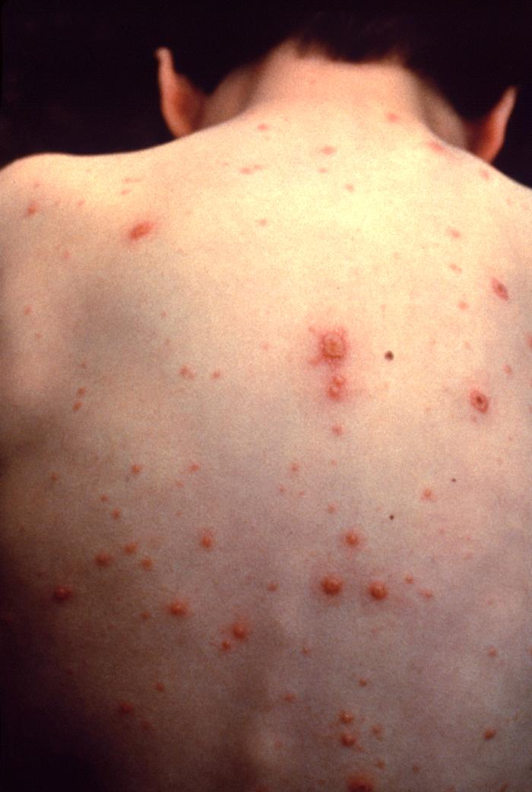
02 / VACCINE-PREVENTABLE DISEASES
Varicella: recognize the pattern
Chickenpox is the primary infection with varicella-zoster virus (VZV).
An itchy rash develops in crops: spots, blisters, and crusts may coexist.
Complications include skin infection, pneumonia, and encephalitis.
Notice lesions at different stages on the same patient.
Severe illness is more likely in adults, pregnancy, and immunosuppression.
Photo: CDC / Public Health Image Library
EMS 313 / Chapter 6
15
Notes:
Teaching narrative:
We begin with chickenpox. Notice that the skin lesions are at different stages at the same time. This pattern can support suspicion but cannot establish the diagnosis on its own. Disease may be more severe in adults, pregnant patients, and people with weakened immunity. Assess breathing and the patient's overall condition.
Source lecture: supplied Chapter 6, Vaccines and Vaccine Preventable Diseases. Content reorganized and updated for teaching.
References (accessed 12 October 2026):
https://www.cdc.gov/chickenpox/hcp/clinical-overview/index.html
Image credit and licence:
CDC / Public Health Image Library. Varicella photograph. https://www.cdc.gov/chickenpox/signs-symptoms/photos.html ; https://www.cdc.gov/chickenpox/images/people_varicella2-lg.jpg . Public-domain US government clinical photograph. Displayed proportionally without alteration.
Clinical application follows current Saudi MOH guidance and local EMS protocols.

Slide 16
02 / VACCINE-PREVENTABLE DISEASES
Varicella: spread and prevention
VZV spreads through airborne particles and contact with blister fluid.
Use Airborne and Contact Precautions in addition to Standard Precautions.
Patients are usually contagious before the rash until all lesions crust.
The varicella vaccine is live attenuated and prevents primary infection.
Cover lesions, limit exposure, and pre-alert the receiving facility.
EMS 313 / Chapter 6
16
Notes:
Teaching narrative:
The skin findings have practical implications: suspected chickenpox requires airborne and contact precautions. Gloves alone are insufficient. Transmission can begin before the rash appears. Patients usually remain infectious until all lesions have crusted. For mild breakthrough cases with lesions that do not crust, guidance uses a period of 24 hours without new lesions. We will now move to a disease in which the airway risk is more obvious.
Source lecture: supplied Chapter 6, Vaccines and Vaccine Preventable Diseases. Content reorganized and updated for teaching.
References (accessed 12 October 2026):
https://www.cdc.gov/chickenpox/hcp/clinical-overview/index.html
https://www.cdc.gov/infection-control/hcp/isolation-precautions/appendix-a-type-duration.html
Clinical application follows current Saudi MOH guidance and local EMS protocols.

Slide 17
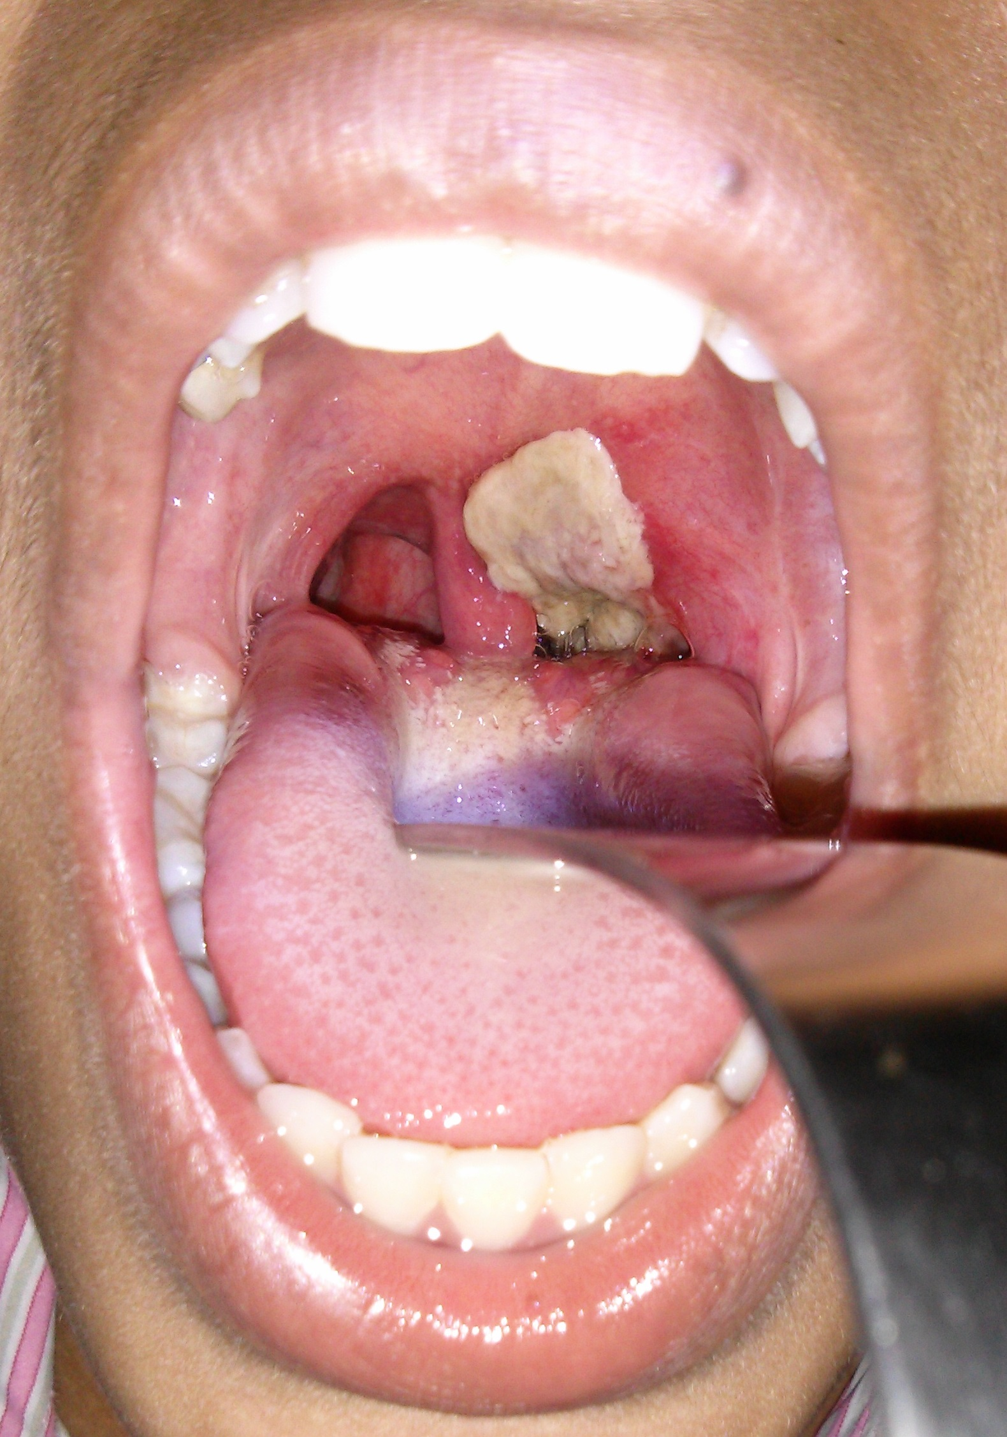
02 / VACCINE-PREVENTABLE DISEASES
Diphtheria: an airway emergency
Toxigenic Corynebacterium diphtheriae can cause severe throat infection.
A thick grey-white pseudomembrane may obstruct the airway.
Toxin can also damage the heart and peripheral nerves.
The adherent pseudomembrane is an important warning sign.
Assess airway and breathing promptly; avoid unnecessary throat manipulation.
Photo: Dileepunnikri / Wikimedia / CC BY-SA 3.0
EMS 313 / Chapter 6
17
Notes:
Teaching narrative:
Look at the membrane in the throat. Diphtheria can obstruct the airway, and its toxin can affect the heart and nerves. Assess the patient early and follow the airway management protocol. Avoid unnecessary manipulation of the membrane. This clinical picture connects with the principle of a vaccine that targets a toxin.
Source lecture: supplied Chapter 6, Vaccines and Vaccine Preventable Diseases. Content reorganized and updated for teaching.
References (accessed 12 October 2026):
https://www.cdc.gov/diphtheria/hcp/clinical-guidance/index.html
Image credit and licence:
Dileepunnikri. Dirty white pseudomembrane classically seen in diphtheria. https://commons.wikimedia.org/wiki/File:Dirty_white_pseudomembrane_classically_seen_in_diphtheria_2013-07-06_11-07.jpg . CC BY-SA 3.0: https://creativecommons.org/licenses/by-sa/3.0/ . Existing Commons image displayed proportionally without further alteration.
Clinical application follows current Saudi MOH guidance and local EMS protocols.

Slide 18
02 / VACCINE-PREVENTABLE DISEASES
Diphtheria: treatment and prevention
Respiratory spread occurs through droplets and secretions.
Suspected respiratory disease requires urgent antibiotics and diphtheria antitoxin.
Diphtheria toxoid is included in combination vaccines.
DTaP is used in young children; Tdap and Td are used for older age groups as indicated.
Respiratory disease: Droplet Precautions. Cutaneous disease: Contact Precautions.
EMS 313 / Chapter 6
18
Notes:
Teaching narrative:
Distinguish treatment of disease from prevention. A patient with strongly suspected respiratory diphtheria may require urgent antibiotics and antitoxin before laboratory confirmation. Vaccination uses an inactivated toxin. D and T refer to diphtheria and tetanus, while aP refers to acellular pertussis. DTaP and Tdap differ in formulation and the age groups for which they are appropriate.
Source lecture: supplied Chapter 6, Vaccines and Vaccine Preventable Diseases. Content reorganized and updated for teaching.
References (accessed 12 October 2026):
https://www.cdc.gov/diphtheria/hcp/clinical-guidance/index.html
https://www.cdc.gov/infection-control/hcp/isolation-precautions/appendix-a-type-duration.html
Clinical application follows current Saudi MOH guidance and local EMS protocols.

Slide 19
02 / VACCINE-PREVENTABLE DISEASES
Hepatitis A: an acute liver infection
Hepatitis A virus spreads mainly by the fecal–oral route.
Exposure can occur through contaminated food, water, or close contact.
Symptoms may include fatigue, nausea, abdominal discomfort, dark urine, and jaundice.
It does not cause chronic infection; treatment is mainly supportive.
Prevention combines vaccination, hand hygiene, and safe food and water.
EMS 313 / Chapter 6
19
Notes:
Teaching narrative:
We now move from respiratory infections to hepatitis. Hepatitis A usually begins when the virus enters through the mouth. Jaundice or dark urine may be present, but symptoms alone do not identify the type of hepatitis. Hepatitis A causes acute infection and does not become chronic, although some patients can develop severe disease.
Source lecture: supplied Chapter 6, Vaccines and Vaccine Preventable Diseases. Content reorganized and updated for teaching.
References (accessed 12 October 2026):
https://www.cdc.gov/hepatitis-a/hcp/clinical-overview/index.html
Clinical application follows current Saudi MOH guidance and local EMS protocols.

Slide 20
02 / VACCINE-PREVENTABLE DISEASES
Hepatitis B: blood and body-fluid exposure
HBV spreads through infected blood and certain body fluids, including during birth.
Acute infection may be silent or cause fatigue, nausea, and jaundice.
Chronic infection can lead to cirrhosis and liver cancer.
Chronicity is age-related: about 90% after infant infection versus about 5% after adult infection.
Most immunocompetent adults recover from acute HBV infection.
EMS 313 / Chapter 6
20
Notes:
Teaching narrative:
Hepatitis B has a different route of transmission and a different potential outcome. It matters to paramedics because of occupational blood exposure. Age strongly affects the risk of chronic infection: the risk is very high following infection in infancy and much lower in immunocompetent adults. Most adults recover from acute infection. Chronic hepatitis B requires specialist follow-up and treatment.
Source lecture: supplied Chapter 6, Vaccines and Vaccine Preventable Diseases. Content reorganized and updated for teaching.
References (accessed 12 October 2026):
https://www.cdc.gov/hepatitis-b/hcp/clinical-overview/index.html
https://www.cdc.gov/pinkbook/hcp/table-of-contents/chapter-10-hepatitis-b.html
Clinical application follows current Saudi MOH guidance and local EMS protocols.

Slide 21
02 / VACCINE-PREVENTABLE DISEASES
Hepatitis A and B: compare prevention
Feature | Hepatitis A | Hepatitis B
Main route | Fecal–oral | Blood and certain body fluids
Chronic infection | No | Possible; highest risk in infancy
Vaccine type | Inactivated | Recombinant protein subunit
EMS focus | Hand hygiene; manage contamination | Sharps safety; vaccination; exposure reporting
After an exposure, seek prompt assessment for vaccine and/or immune globulin.
EMS 313 / Chapter 6
21
Notes:
Teaching narrative:
This table compares hepatitis A and B. Hepatitis A usually spreads through the fecal-oral route, while hepatitis B spreads through blood and certain body fluids. Vaccination can prevent both, but vaccine types and post-exposure management differ. After a needlestick injury, report the exposure immediately. Assessment considers the type of exposure, vaccination history, and documented vaccine response when relevant.
Source lecture: supplied Chapter 6, Vaccines and Vaccine Preventable Diseases. Content reorganized and updated for teaching.
References (accessed 12 October 2026):
https://www.cdc.gov/hepatitis-a/hcp/clinical-overview/index.html
https://www.cdc.gov/hepatitis-b/hcp/clinical-overview/index.html
Clinical application follows current Saudi MOH guidance and local EMS protocols.

Slide 22
02 / VACCINE-PREVENTABLE DISEASES
Influenza: recognize and reduce risk
Typical illness starts abruptly with cough, fever, headache, fatigue, and muscle aches.
Older or immunocompromised patients may have little or no fever.
Complications include pneumonia and worsening of chronic disease.
Annual vaccination reduces risk; early antivirals are important for selected high-risk or severely ill patients.
Use Droplet Precautions and assess respiratory distress promptly.
EMS 313 / Chapter 6
22
Notes:
Teaching narrative:
Influenza is common, but it can cause serious illness. Sudden onset of muscle aches and cough can support suspicion. Older adults and immunocompromised patients may have influenza without fever. Assess oxygenation and the work of breathing. Vaccination is seasonal. Non-live vaccines are available, and a live nasal vaccine is an option for eligible groups under local guidance.
Source lecture: supplied Chapter 6, Vaccines and Vaccine Preventable Diseases. Content reorganized and updated for teaching.
References (accessed 12 October 2026):
https://www.cdc.gov/flu/hcp/clinical-signs/index.html
https://www.cdc.gov/flu/hcp/infection-control/healthcare-settings.html
Clinical application follows current Saudi MOH guidance and local EMS protocols.

Slide 23
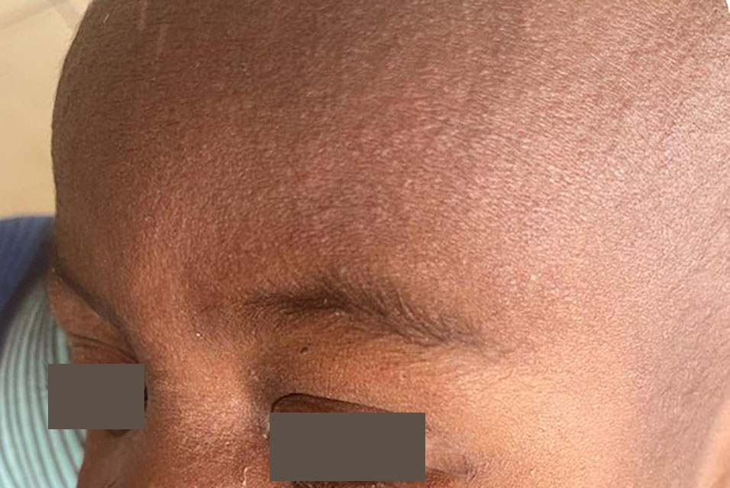
02 / VACCINE-PREVENTABLE DISEASES
Measles: fever followed by rash
Early features include high fever, cough, runny nose, and red eyes.
Koplik spots may appear inside the mouth.
The rash usually starts on the face and spreads downward.
Complications include pneumonia and encephalitis.
A measles rash: assess the complete clinical and exposure history.
Suspect measles early in an unvaccinated patient with fever and rash.
Photo: CDC
EMS 313 / Chapter 6
23
Notes:
Teaching narrative:
Imagine a patient with fever, cough, and red eyes who then develops a rash. This pattern should raise suspicion of measles. The photograph supports recognition, but it is not a diagnostic test. Ask about exposure, travel, and vaccination history. Begin appropriate precautions when measles is suspected, before laboratory results are available.
Source lecture: supplied Chapter 6, Vaccines and Vaccine Preventable Diseases. Content reorganized and updated for teaching.
References (accessed 12 October 2026):
https://www.cdc.gov/measles/hcp/clinical-overview/index.html
Image credit and licence:
CDC. Measles clinical image. https://www.cdc.gov/measles/signs-symptoms/photos.html ; https://www.cdc.gov/measles/media/images/2024/05/IMAGE-00010_large.png . Public-domain US government clinical photograph. Original includes privacy masking; displayed proportionally without alteration.
Clinical application follows current Saudi MOH guidance and local EMS protocols.

Slide 24
02 / VACCINE-PREVENTABLE DISEASES
Measles: an airborne infection
Virus can remain infectious in the air for up to 2 hours after a patient leaves.
Use Airborne Precautions, including a fit-tested N95 or equivalent respirator.
Mask the patient if tolerated and pre-alert the hospital.
MMR is a live attenuated vaccine against measles, mumps, and rubella.
A surgical mask on the provider is not sufficient airborne protection.
EMS 313 / Chapter 6
24
Notes:
Teaching narrative:
Early suspicion matters because measles spreads through the air, and the virus can remain after the patient has left. A surgical mask on the patient can help reduce spread if tolerated. Healthcare workers need respiratory protection appropriate for airborne precautions. Vaccination is important, and the required protective equipment must still be used during patient care.
Source lecture: supplied Chapter 6, Vaccines and Vaccine Preventable Diseases. Content reorganized and updated for teaching.
References (accessed 12 October 2026):
https://www.cdc.gov/measles/hcp/clinical-overview/index.html
https://www.cdc.gov/infection-control/hcp/isolation-precautions/appendix-a-type-duration.html
Clinical application follows current Saudi MOH guidance and local EMS protocols.

Slide 25
02 / VACCINE-PREVENTABLE DISEASES
Meningococcal disease: rapid deterioration
Neisseria meningitidis can cause meningitis or bloodstream infection.
Fever, headache, neck stiffness, or altered mental status may occur.
A non-blanching petechial or purpuric rash may develop.
Sepsis and shock can progress rapidly, sometimes before a rash appears.
Do not wait for a rash before recognizing and treating possible sepsis.
EMS 313 / Chapter 6
25
Notes:
Teaching narrative:
Meningococcal disease can deteriorate rapidly. Fever with altered mental status or signs of shock is concerning even when no rash is present. The patient may have meningitis or a bloodstream infection. Follow the protocol for sepsis assessment, resuscitation, and urgent transport. Do not delay care while waiting for a rash or neck stiffness.
Source lecture: supplied Chapter 6, Vaccines and Vaccine Preventable Diseases. Content reorganized and updated for teaching.
References (accessed 12 October 2026):
https://www.cdc.gov/meningococcal/hcp/clinical-guidance/index.html
Clinical application follows current Saudi MOH guidance and local EMS protocols.

Slide 26
02 / VACCINE-PREVENTABLE DISEASES
Meningococcal disease: prevention
Spread requires close contact with respiratory or throat secretions.
Use Droplet Precautions; definitive treatment requires urgent antibiotics.
MenACWY and MenB vaccines cover different serogroups.
Unprotected secretion exposure may require antibiotic prophylaxis after assessment.
Vaccination does not replace assessment after a qualifying exposure.
EMS 313 / Chapter 6
26
Notes:
Teaching narrative:
Meningococcal disease requires droplet precautions. Team members may have a significant exposure during airway procedures performed without appropriate protection. MenACWY and MenB vaccines cover different meningococcal groups, so one vaccine does not necessarily cover all groups. Some vaccination requirements relate to travel and Hajj. Follow current Saudi guidance.
Source lecture: supplied Chapter 6, Vaccines and Vaccine Preventable Diseases. Content reorganized and updated for teaching.
References (accessed 12 October 2026):
https://www.cdc.gov/meningococcal/hcp/clinical-guidance/index.html
https://www.cdc.gov/infection-control/hcp/isolation-precautions/appendix-a-type-duration.html
Clinical application follows current Saudi MOH guidance and local EMS protocols.

Slide 27
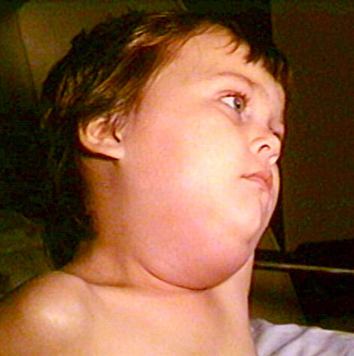
02 / VACCINE-PREVENTABLE DISEASES
Mumps: painful parotid swelling
Mumps commonly causes swelling near the jaw and ear.
Fever, headache, and malaise may accompany parotitis.
Complications include orchitis, meningitis, and hearing loss.
Care is mainly supportive; MMR provides prevention.
Parotid gland swelling can change the outline of the jaw.
Spread: saliva and respiratory droplets. Use Droplet Precautions.
Photo: CDC / NIP / Barbara Rice
EMS 313 / Chapter 6
27
Notes:
Teaching narrative:
For mumps, focus on the face and jaw. Parotid swelling may affect one side or both sides. Ask about pain, fever, and exposure. Complications may involve the testes, the nervous system, or hearing. MMR appears again here because it combines protection against three different diseases in one vaccine.
Source lecture: supplied Chapter 6, Vaccines and Vaccine Preventable Diseases. Content reorganized and updated for teaching.
References (accessed 12 October 2026):
https://www.cdc.gov/mumps/signs-symptoms/index.html
https://www.cdc.gov/infection-control/hcp/isolation-precautions/appendix-a-type-duration.html
Image credit and licence:
CDC / NIP / Barbara Rice. Mumps, PHIL 130. https://commons.wikimedia.org/wiki/File:Mumps_PHIL_130_lores.jpg . Public domain. Existing Commons crop displayed proportionally without further alteration.
Clinical application follows current Saudi MOH guidance and local EMS protocols.

Slide 28
02 / VACCINE-PREVENTABLE DISEASES
Pertussis: more than a prolonged cough
Bordetella pertussis first causes cold-like symptoms.
Later, repeated coughing fits may cause vomiting or an inspiratory “whoop”.
Infants may present with apnea and little obvious cough.
Pneumonia, hypoxia, and feeding difficulty can make infant disease severe.
An infant with apnea needs urgent assessment even without a classic whoop.
EMS 313 / Chapter 6
28
Notes:
Teaching narrative:
Pertussis does not always begin with the characteristic whoop. Early symptoms may resemble a common cold, followed by bouts of coughing. The key point for paramedics is that an infant may develop apnea without an obvious cough. Assess breathing, oxygenation, feeding, and the overall condition. Treat immediate threats promptly rather than waiting for the classic presentation.
Source lecture: supplied Chapter 6, Vaccines and Vaccine Preventable Diseases. Content reorganized and updated for teaching.
References (accessed 12 October 2026):
https://www.cdc.gov/pertussis/hcp/clinical-signs/index.html
Clinical application follows current Saudi MOH guidance and local EMS protocols.

Slide 29
02 / VACCINE-PREVENTABLE DISEASES
Pertussis: prevention and early treatment
Use Droplet Precautions for suspected disease.
Antibiotics started early can reduce symptom severity and transmission.
Later treatment may not shorten an established cough illness.
DTaP and Tdap contain acellular pertussis antigens; protection can wane.
Post-exposure prophylaxis is considered for defined high-risk contacts.
EMS 313 / Chapter 6
29
Notes:
Teaching narrative:
Timing matters in pertussis treatment. Antibiotics are more useful in reducing symptom severity when given early. Cough can persist once the illness has progressed to severe coughing episodes. Prevention includes vaccination appropriate to age and clinical circumstances, along with public health assessment of contacts at risk of serious complications.
Source lecture: supplied Chapter 6, Vaccines and Vaccine Preventable Diseases. Content reorganized and updated for teaching.
References (accessed 12 October 2026):
https://www.cdc.gov/pertussis/hcp/clinical-care/index.html
https://www.cdc.gov/pertussis/hcp/vaccine-recommendations/index.html
https://www.cdc.gov/infection-control/hcp/isolation-precautions/appendix-a-type-duration.html
Clinical application follows current Saudi MOH guidance and local EMS protocols.

Slide 30
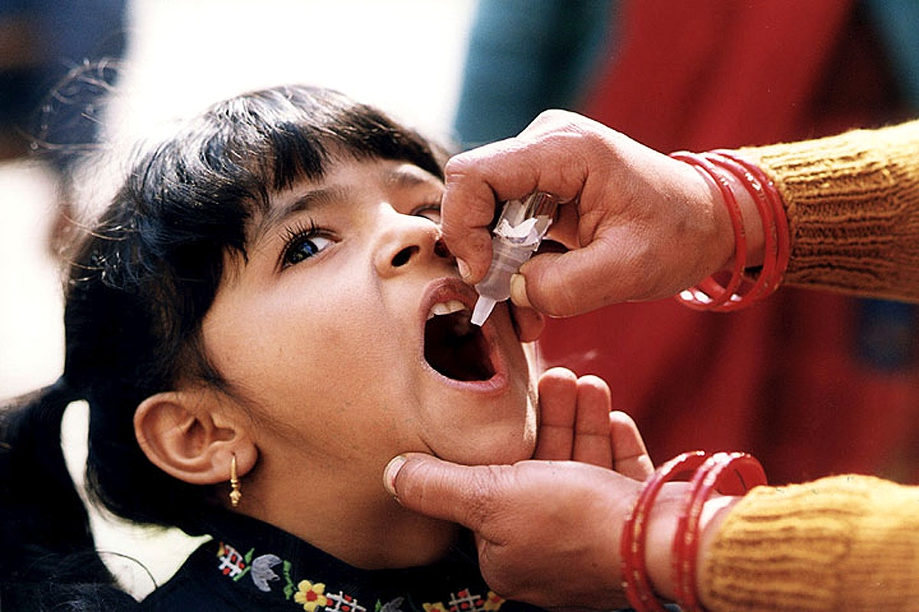
02 / VACCINE-PREVENTABLE DISEASES
Polio: prevent paralysis
Poliovirus spreads mainly through the fecal–oral route.
Most infections do not cause obvious symptoms.
A small proportion cause acute flaccid weakness or paralysis.
Respiratory muscle involvement can be life-threatening.
Oral vaccine administration illustrates one polio prevention strategy.
New acute flaccid weakness requires urgent assessment and notification.
Photo: CDC / Public Health Image Library
EMS 313 / Chapter 6
30
Notes:
Teaching narrative:
Most people infected with poliovirus have no obvious symptoms, but some develop neurological disease with flaccid weakness or paralysis. New acute weakness requires assessment for serious causes and immediate evaluation of breathing. The photograph shows oral polio vaccine administration and introduces the comparison between the two vaccine types. Vaccine selection depends on the individual and the applicable guidance.
Source lecture: supplied Chapter 6, Vaccines and Vaccine Preventable Diseases. Content reorganized and updated for teaching.
References (accessed 12 October 2026):
https://www.cdc.gov/polio/about/index.html
https://www.cdc.gov/polio/vaccines/index.html
Image credit and licence:
CDC / Public Health Image Library. Oral polio vaccine administration. https://commons.wikimedia.org/wiki/File:Oral_Polio_Vaccine.jpg . Public domain. Displayed proportionally without alteration.
Clinical application follows current Saudi MOH guidance and local EMS protocols.

Slide 31
02 / VACCINE-PREVENTABLE DISEASES
Polio vaccines: IPV and OPV
Feature | IPV | OPV
Type and route | Inactivated; injection | Live attenuated; oral drops
Main strength | Strong protection against paralysis | Strong intestinal immunity
Vaccine-virus risk | No replication or vaccine-derived virus | Rare vaccine-associated or derived poliovirus risks
Use | Follow national schedules and travel guidance | Use depends on national and outbreak programmes
Product choice follows current national policy—not a general preference.
EMS 313 / Chapter 6
31
Notes:
Teaching narrative:
The distinction between polio vaccines extends beyond injection versus oral drops. Inactivated polio vaccine provides strong protection against paralysis and cannot replicate. Oral polio vaccine produces intestinal immunity that helps interrupt transmission, but it carries rare risks associated with the vaccine virus. Use depends on national policy and outbreak circumstances. Apply current Saudi recommendations when using the local schedule.
Source lecture: supplied Chapter 6, Vaccines and Vaccine Preventable Diseases. Content reorganized and updated for teaching.
References (accessed 12 October 2026):
https://www.cdc.gov/polio/vaccines/index.html
https://www.cdc.gov/pinkbook/hcp/table-of-contents/chapter-1-principles-of-vaccination.html
Clinical application follows current Saudi MOH guidance and local EMS protocols.

Slide 32
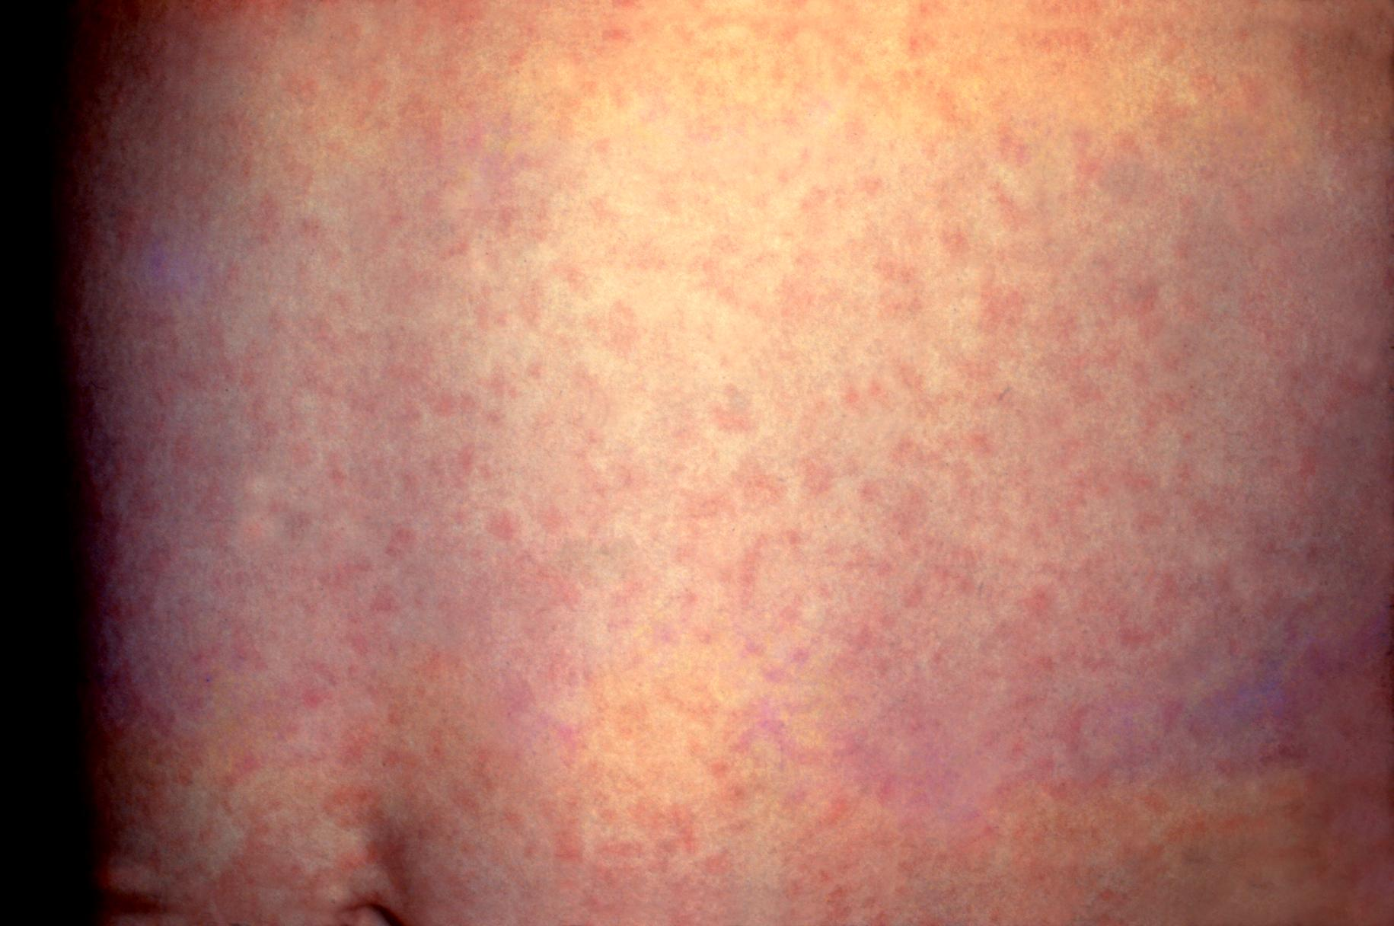
02 / VACCINE-PREVENTABLE DISEASES
Rubella: recognition and prevention
Rubella may cause a mild rash, low fever, and enlarged lymph nodes.
Some infections have few or no symptoms.
Respiratory droplets spread the virus.
MMR vaccination prevents rubella.
A rubella rash may be subtle and is not diagnostic by appearance alone.
The greatest concern is infection during pregnancy.
Photo: CDC / Public Health Image Library
EMS 313 / Chapter 6
32
Notes:
Teaching narrative:
Rubella may appear milder than measles, but its importance extends beyond symptom severity in the infected person. Infection can be mild or unnoticed and still pose a serious risk during pregnancy. The next slide moves from the appearance of the rash to the possible effects on the fetus.
Source lecture: supplied Chapter 6, Vaccines and Vaccine Preventable Diseases. Content reorganized and updated for teaching.
References (accessed 12 October 2026):
https://www.cdc.gov/rubella/signs-symptoms/index.html
https://www.cdc.gov/infection-control/hcp/isolation-precautions/appendix-a-type-duration.html
Image credit and licence:
CDC / Public Health Image Library, image 4514. Rubella rash. https://commons.wikimedia.org/wiki/File:Rubella.jpg . Public domain. Displayed proportionally without alteration.
Clinical application follows current Saudi MOH guidance and local EMS protocols.

Slide 33
02 / VACCINE-PREVENTABLE DISEASES
Rubella and pregnancy
Infection during pregnancy can cause miscarriage, fetal death, or congenital rubella syndrome.
Congenital effects include hearing loss, eye defects, and congenital heart disease.
Rubella immunity should be reviewed before pregnancy when possible.
MMR is a live vaccine and is not given during pregnancy; susceptible patients can be vaccinated postpartum.
EMS 313 / Chapter 6
33
Notes:
Teaching narrative:
A mild illness in the mother can have serious consequences for the pregnancy and fetus. Congenital rubella may affect hearing, the eyes, and the heart. Prevention includes confirming immunity before pregnancy. MMR should not be given during pregnancy. Suspected exposure requires early assessment, and patients who need vaccination can receive it after delivery.
Source lecture: supplied Chapter 6, Vaccines and Vaccine Preventable Diseases. Content reorganized and updated for teaching.
References (accessed 12 October 2026):
https://www.cdc.gov/rubella/signs-symptoms/index.html
https://www.cdc.gov/pinkbook/hcp/table-of-contents/chapter-2-general-best-practice-guidance.html
Clinical application follows current Saudi MOH guidance and local EMS protocols.

Slide 34
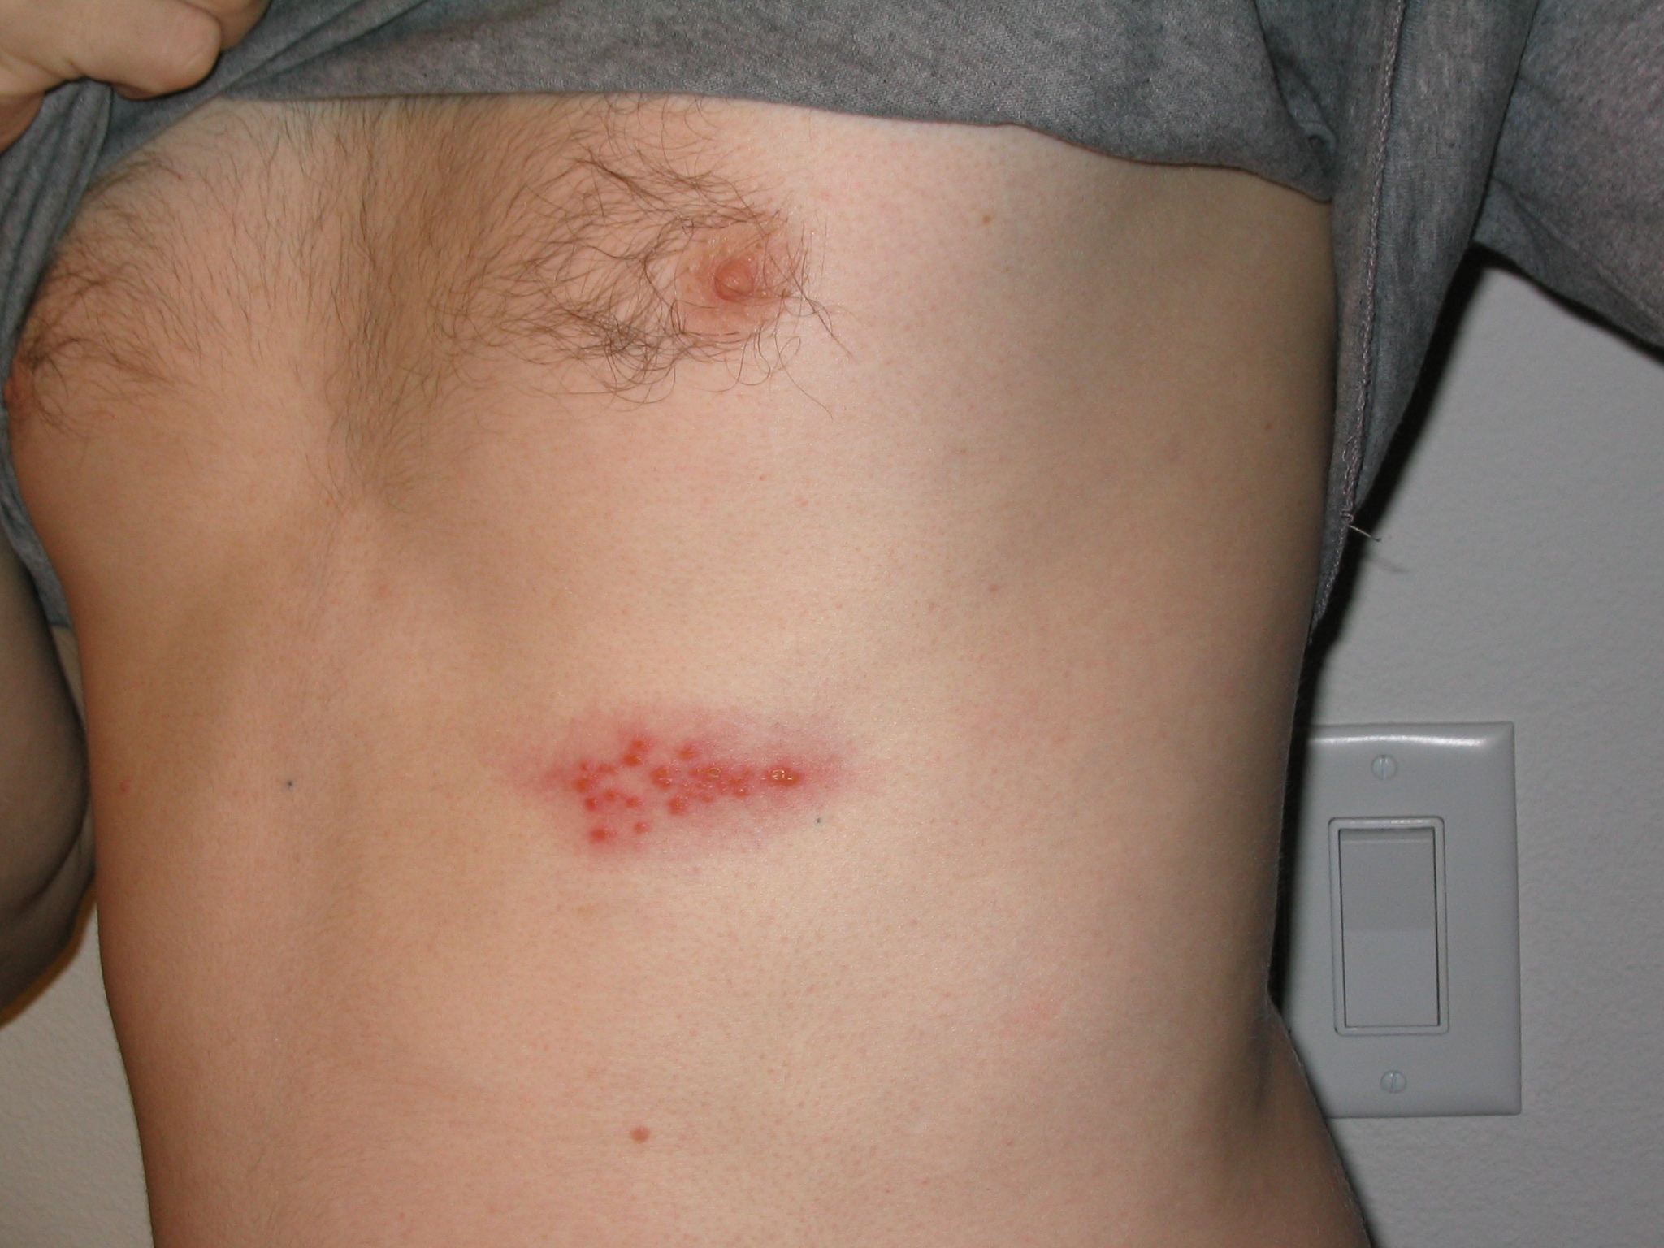
02 / VACCINE-PREVENTABLE DISEASES
Shingles: reactivation of VZV
VZV remains latent after chickenpox and may reactivate later.
Pain, burning, or tingling may precede a one-sided blistering rash.
The rash usually follows a dermatome: an area supplied by one sensory nerve.
Persistent nerve pain is called postherpetic neuralgia.
Notice the grouped blisters on one side of the chest.
Eye involvement or widespread disease needs urgent evaluation.
Photo: Preston Hunt / Wikimedia / CC BY 3.0
EMS 313 / Chapter 6
34
Notes:
Teaching narrative:
We return to the virus responsible for chickenpox. Shingles results from reactivation of a virus that has remained latent after the initial infection. Pain with a rash on one side of the body supports suspicion. Nerve pain may persist after the lesions disappear. Eye involvement or disseminated disease in an immunocompromised patient can cause serious complications.
Source lecture: supplied Chapter 6, Vaccines and Vaccine Preventable Diseases. Content reorganized and updated for teaching.
References (accessed 12 October 2026):
https://www.cdc.gov/shingles/signs-symptoms/index.html
https://www.moh.gov.sa/en/healthawareness/educationalcontent/diseases/dermatology/pages/shingles-1.aspx
Image credit and licence:
Preston Hunt. Shingles on the chest. https://commons.wikimedia.org/wiki/File:Shingles_on_the_chest.jpg . CC BY 3.0: https://creativecommons.org/licenses/by/3.0/ . Displayed proportionally without alteration.
Clinical application follows current Saudi MOH guidance and local EMS protocols.

Slide 35
02 / VACCINE-PREVENTABLE DISEASES
Shingles: vaccine and transmission
The recombinant zoster vaccine (RZV) is non-live and given as a two-dose series.
Saudi MOH guidance includes adults aged 50+ and immunocompromised adults aged 18+.
VZV from shingles can cause chickenpox in a susceptible contact.
Cover lesions; precautions depend on extent of disease and immune status.
RZV prevents shingles; it is not a substitute for the varicella vaccine.
EMS 313 / Chapter 6
35
Notes:
Teaching narrative:
The recombinant shingles vaccine is non-live. The Saudi Ministry of Health page identifies the relevant groups. Consult the latest guidance for eligibility details and dose intervals. A susceptible contact exposed to the virus may develop chickenpox. Shingles itself results from reactivation. The required precautions depend on the extent of the lesions and the patient's immune status.
Source lecture: supplied Chapter 6, Vaccines and Vaccine Preventable Diseases. Content reorganized and updated for teaching.
References (accessed 12 October 2026):
https://www.cdc.gov/shingles/hcp/vaccine-considerations/index.html
https://www.moh.gov.sa/en/healthawareness/educationalcontent/diseases/dermatology/pages/shingles-1.aspx
https://www.cdc.gov/infection-control/hcp/isolation-precautions/appendix-a-type-duration.html
Clinical application follows current Saudi MOH guidance and local EMS protocols.

Slide 36
02 / VACCINE-PREVENTABLE DISEASES
Tetanus: a toxin-mediated emergency
Clostridium tetani spores enter through wounds or breaks in the skin.
Toxin blocks inhibitory nerve signals, causing rigidity and painful spasms.
Lockjaw, swallowing difficulty, and respiratory compromise may occur.
Tetanus does not spread from person to person.
Suspected tetanus requires urgent hospital care and close airway monitoring.
EMS 313 / Chapter 6
36
Notes:
Teaching narrative:
We finish the disease section with tetanus. Infection usually begins when environmental spores enter a wound. The toxin interferes with inhibitory nerve signals, producing rigidity and spasms. Focus on the airway, breathing, monitoring, and transport according to protocol. Tetanus does not spread from person to person, but it can be life-threatening for the affected patient.
Source lecture: supplied Chapter 6, Vaccines and Vaccine Preventable Diseases. Content reorganized and updated for teaching.
References (accessed 12 October 2026):
https://www.cdc.gov/tetanus/hcp/clinical-overview/index.html
https://www.cdc.gov/infection-control/hcp/isolation-precautions/appendix-a-type-duration.html
Clinical application follows current Saudi MOH guidance and local EMS protocols.

Slide 37
02 / VACCINE-PREVENTABLE DISEASES
Tetanus prevention after a wound
Clean the wound and remove foreign material as clinically appropriate.
Review the wound type and documented vaccination history.
Give a tetanus-containing vaccine when indicated by the current protocol.
TIG may also be required for selected dirty or major wounds and susceptible patients.
TIG provides passive antibodies; the vaccine builds active immunity.
EMS 313 / Chapter 6
37
Notes:
Teaching narrative:
This brings us back to active and passive immunity. After some wounds, a patient may need a tetanus vaccine and may also need tetanus immune globulin, or TIG. The decision depends on the wound, vaccination history, and immune status. TIG is not required for every wound. A small wound can still present a risk. Wound care and a documented assessment are essential parts of prevention.
Source lecture: supplied Chapter 6, Vaccines and Vaccine Preventable Diseases. Content reorganized and updated for teaching.
References (accessed 12 October 2026):
https://www.cdc.gov/tetanus/hcp/clinical-guidance/index.html
Clinical application follows current Saudi MOH guidance and local EMS protocols.

Slide 38
03 / APPLICATION AND REVIEW
Respiratory precautions: key comparisons
Suspected disease | Additional precautions | Practical reminder
Measles | Airborne | Fit-tested N95 or equivalent
Varicella | Airborne + Contact | Cover lesions; limit exposure
Influenza; respiratory diphtheria | Droplet | Mask patient if tolerated
Meningococcal disease; mumps; pertussis; acquired rubella | Droplet | Pre-alert and assess relevant exposures
Standard Precautions always apply. Follow procedure-specific PPE guidance.
EMS 313 / Chapter 6
38
Notes:
Teaching narrative:
Use this table to compare diseases. No single sign can establish a diagnosis. The main distinction is between measles and chickenpox, which require airborne precautions, and the diseases for which droplet precautions are added. Standard precautions always apply. Aerosol-generating procedures may require additional protection under the facility's protocol. Rubella here refers to acquired infection. Congenital cases have different precaution requirements.
Source lecture: supplied Chapter 6, Vaccines and Vaccine Preventable Diseases. Content reorganized and updated for teaching.
References (accessed 12 October 2026):
https://www.cdc.gov/infection-control/hcp/isolation-precautions/appendix-a-type-duration.html
https://www.cdc.gov/flu/hcp/infection-control/healthcare-settings.html
Clinical application follows current Saudi MOH guidance and local EMS protocols.

Slide 39
03 / APPLICATION AND REVIEW
Using vaccination guidance in Saudi Arabia
Use the current Saudi MOH schedule for routine childhood doses and catch-up needs.
Review adult vaccination according to age, health conditions, pregnancy, and prior doses.
Healthcare workers need documented vaccination and immunity according to occupational-health policy.
Check current Hajj, Umrah, and travel requirements for the relevant season and destination.
Use the patient’s record plus current guidance; do not rely on an old schedule image.
EMS 313 / Chapter 6
40
Notes:
Teaching narrative:
After understanding the principles, we need a practical source appropriate to Saudi Arabia. Review the person's vaccination record and the latest Ministry of Health guidance. Consider age, pregnancy, medical conditions, occupation, and travel. The goal is to use the correct current schedule. Details and seasonal requirements can change, so an older schedule image is insufficient for a current clinical decision.
Source lecture: supplied Chapter 6, Vaccines and Vaccine Preventable Diseases. Content reorganized and updated for teaching.
References (accessed 12 October 2026):
https://www.moh.gov.sa/en/healthawareness/educationalcontent/vaccination/pages/vaccination1.aspx
https://www.moh.gov.sa/en/healthawareness/educationalcontent/babyhealth/pages/child-vaccinations.aspx
Clinical application follows current Saudi MOH guidance and local EMS protocols.

Slide 40
03 / APPLICATION AND REVIEW
Selected references and image credits
CDC. Epidemiology and Prevention of Vaccine-Preventable Diseases (Pink Book): principles, best practice, and immunization strategies.
CDC. Current disease-specific clinical guidance and Isolation Precautions, Appendix A.
Saudi Ministry of Health. Vaccination guidance and shingles education.
Clinical photographs: CDC / PHIL; Dileepunnikri (CC BY-SA 3.0); Preston Hunt (CC BY 3.0).
Full source URLs and image licences are included in the relevant speaker notes.
EMS 313 / Chapter 6
44
Notes:
Teaching narrative:
The original teaching source is Chapter 6 of the supplied presentation. Supporting references include CDC and the Saudi Ministry of Health. Each slide's notes include the relevant source links and, where applicable, image credits and licences. The photographs are teaching examples and do not replace clinical assessment or laboratory diagnosis. The original presentation records the online reference review in October 2026.
Source lecture: supplied Chapter 6, Vaccines and Vaccine Preventable Diseases. Content reorganized and updated for teaching.
References (accessed 12 October 2026):
https://www.cdc.gov/pinkbook/hcp/table-of-contents/index.html
https://www.cdc.gov/infection-control/hcp/isolation-precautions/appendix-a-type-duration.html
https://www.moh.gov.sa/en/healthawareness/educationalcontent/vaccination/pages/vaccination1.aspx
https://www.moh.gov.sa/en/healthawareness/educationalcontent/diseases/dermatology/pages/shingles-1.aspx
Clinical application follows current Saudi MOH guidance and local EMS protocols.

